Slide 1

Capstone Design (2)
2nd week : Team Project Topic Selection & Overview
Date | 2019.03.11
Presenter | 이동현
Team | 공찬형, 금강현, 이동현

Slide 2
Index
Project Overview
Problem Recognition
Project Summary
Functional Details
Regular Reservation
Non-regular Reservation(번개)
Ranking System
How to Implement
Project Schedules & Roles
Q&A

Slide 3
1. Project Overview : Problem Recognition
Reservation procedure is too complicated
Difficult to gather the number of players for the game
47%
17%
There is an increasing trend in participation in sports throughout the age range
47% of the population who do not participate in sports is because of a lack of time
About 17% of the population who do not participate in sports is associated with physical activity infrastructure
Reference : KOSIS

Slide 4






1. Project Overview : Project Summary
Building a sports platform for the life
Regular Reservation : Schedule team competition once a month
Non-Regular Reservation : Participate unplanned competition with strangers
Ranking System : Occupy the gym based on team Rank and competitions
14/22
star7
2. ABC
3. Korea
4. S6
…

Slide 5
2. Functional Details : Regular Reservation
Make regular reservations once a month
Select the desired place, date and time and get approval from gym administrator
No one can make Additional Reservation in Already Reserved Time
Service for Official Event, Competition, etc.. ➔ Able to gather official team records
Mencenery Soldiers (용병)

Slide 6
2. Functional Details : Non-regular Reservation
Additional reservations for those who did not apply at the Regular Reservation
A person / team who doesn’t have enough teammate for playing competitions
A person who want to exercise together with strangers
You can get confirmed by gym administrator if you gather enough people to play
Able to collect personal record through Non-regular reservation competition
14/22

Slide 7
2. Functional Details : Ranking System
Group Management Service : Register or Join a Team
Team Competition
Match Result Aggregation
Ranking System
Gym Occupation System through League in Each Gym
Recommendation Service
Matching Opponent Team based on Skill And Record
Recommend Proper Team Composition in Non-regular match
star7
2. ABC
3. Korea
4. S6
…
Team Name : star7
Team’s main subject : Soccer
Team Score : 145 / 157 (92%)
Recent Records :
S
star7 vs ABC | 3 : 2 (win)
star7 vs Korea | 4 : 1 (win)
star7 vs ABC | 1 : 0 (win)

Slide 8
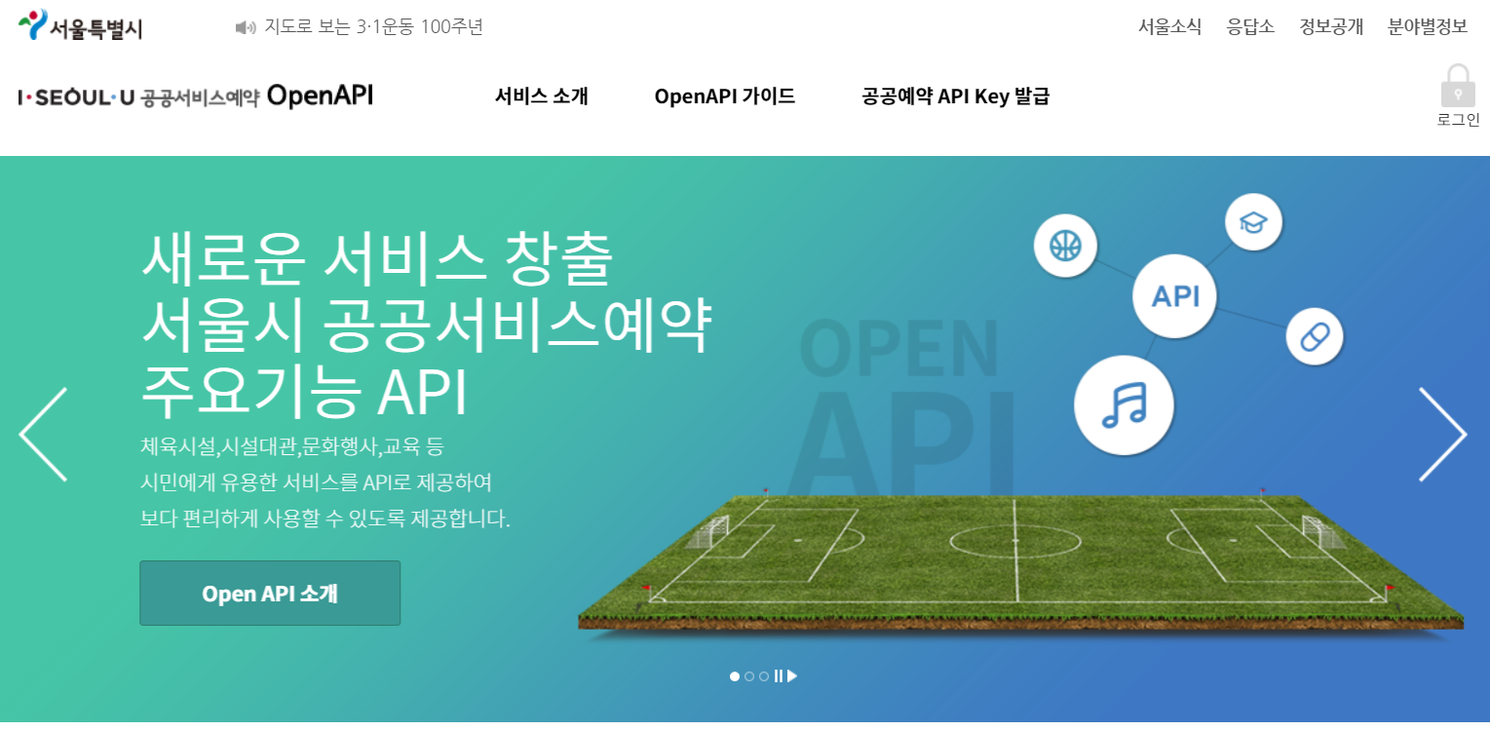



3. How to Implement
Web Page
Spring + JSP
OpenAPI (https://yeyakapi.seoul.go.kr)
Web App
React
AWS Server
EC2
Database
MySQL

Slide 9
3. How to Implement
Dates Task Descriptions | March |  |  |  | April |  |  |  |  | May |  |  |  | June
 | 4 | 11 | 18 | 25 | 1 | 8 | 15 | 22 | 29 | 6 | 13 | 20 | 27 | 3 | 10 | 17
Team Organization |  |  |  |  |  |  | Midterm Demonstration & Presentation |  |  |  |  |  |  | Final Demonstration & Presentation
Subject Confirmation / Write out the Proposal
Web UI Design
Web Structure Construction
Data gathering & Generation / Data modeling
Database Construction
App UI Design
App Structure Construction
Preparing for Mid-Demo
Functional Implementation : Regular Reservation
Functional Implementation : Non-regular Reservation
Functional Implementation : Ranking System
Test and Debugging
Preparing for Final Demo
Writing Manuals and Reports

Slide 10
Q & A

